Slide 1
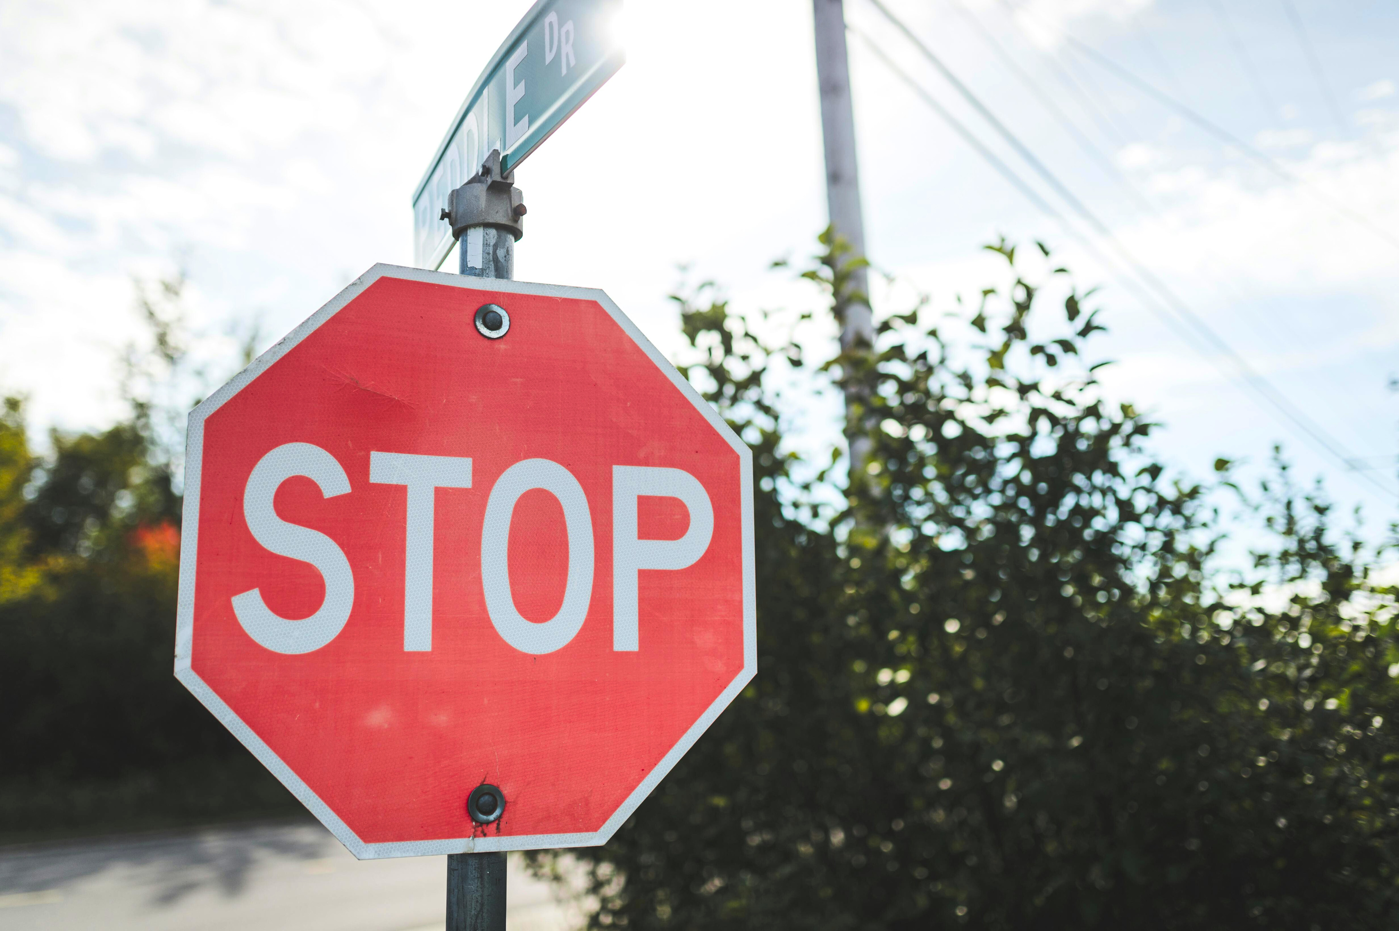


TRAFFIC
GROUP 8
sign detection using
machine learning
Yakin Nazif - 2131862642
Unaiza Nawar Tanisha - 2131103642
Md. Rakibul Islam Rakib - 1911977042
Md. Mobenul Islam Chowdhury - 2012022042

Slide 2
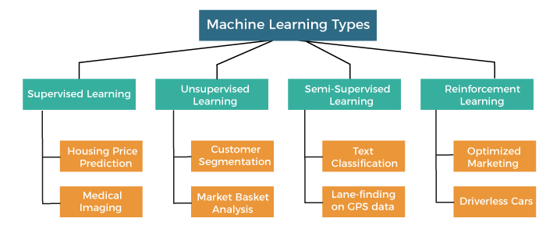
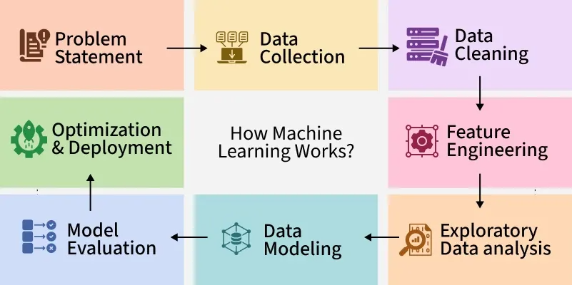

Importance of topic:
Apply classroom ML concepts to real-world problems.
Gain hands-on experience with data processing and model deployment.
Contribute to safer roads through AI innovation.
Group 8: Yakin Nazif Unaiza Nawar Tanisha Md. Rakibul Islam Rakib Md. Mobenul Islam Chowdhury

Slide 3
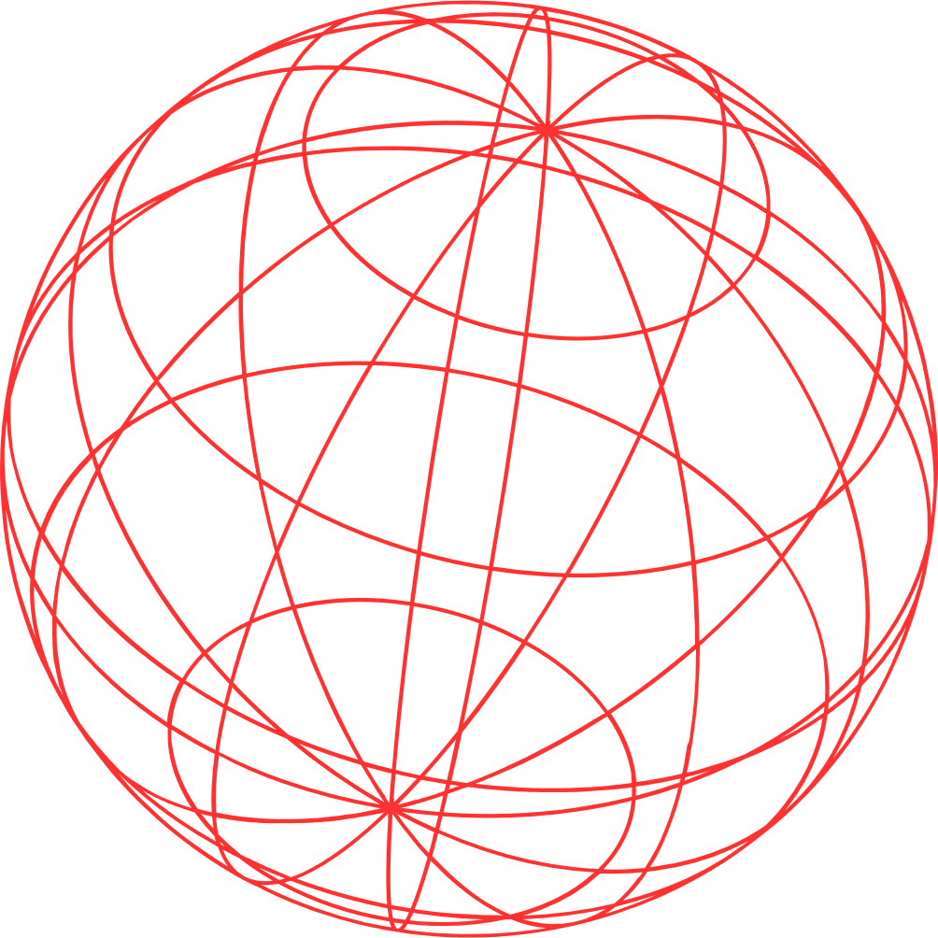

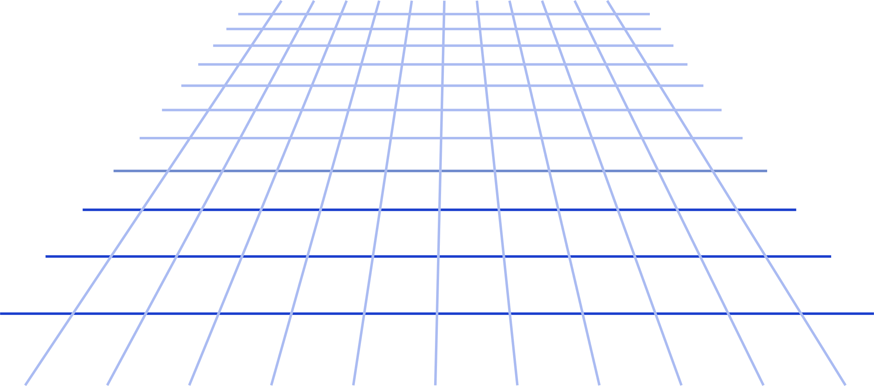
Objective
Detect stop signs in real-time images using machine learning.
Significance of topic
Improves road safety and supports autonomous vehicles.
Challenges
Variations in lighting, weather, viewing angles, and complex backgrounds.
Group 8: Yakin Nazif Unaiza Nawar Tanisha Md. Rakibul Islam Rakib Md. Mobenul Islam Chowdhury

Slide 4

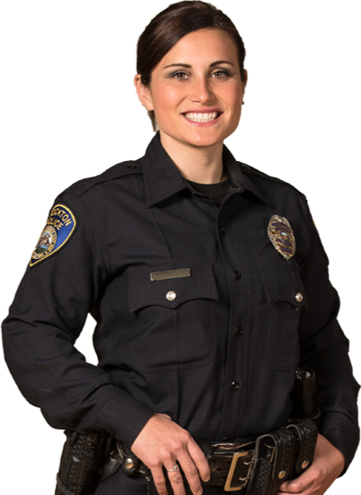
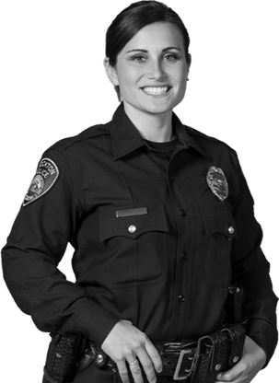

Dataset collected:
100 images:
50 stop signs in diverse conditions
50 negative street scenes
Preprocessing procedure:
Resized to uniform dimensions → Converted to grayscale → Extracted HOG features
Group 8: Yakin Nazif Unaiza Nawar Tanisha Md. Rakibul Islam Rakib Md. Mobenul Islam Chowdhury

Slide 5


Models used:
Random Forest
Template Matching
K Nearest Neighbor
Support Vector Machine (SVM)
(Best Output)
Group 8: Yakin Nazif Unaiza Nawar Tanisha Md. Rakibul Islam Rakib Md. Mobenul Islam Chowdhury

Slide 6
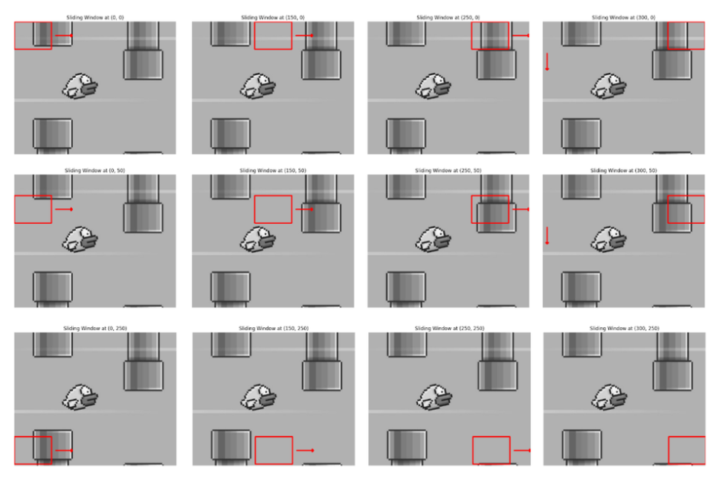
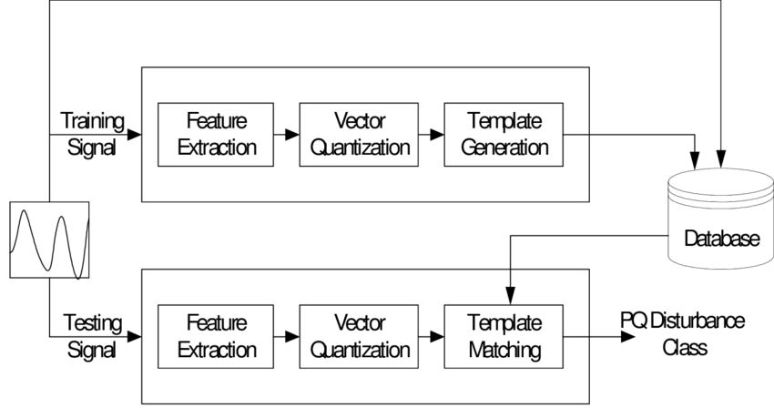
Model overview: Template Matching
A technique in image processing where a ​template image is slid over ​a larger image to find a match.​ Uses correlation or similarity metrics to determine matches.
Group 8: Yakin Nazif Unaiza Nawar Tanisha Md. Rakibul Islam Rakib Md. Mobenul Islam Chowdhury

Slide 7
Model Overview: K nearest Neighbor
Effective for binary classification tasks. ​
Uses hyperplanes to separate data points.
A distance-based classifier that assigns class labels basedon the majority class among the k-nearest neighbors. ​
Simple to implement and interpret.
Training & Testing
Train-Test Split: 80% of the data was used for training,and 20% for testing. ​
Metrics Used: ​Accuracy ​, Precision , ​Recall , F1 Score
Group 8: Yakin Nazif Unaiza Nawar Tanisha Md. Rakibul Islam Rakib Md. Mobenul Islam Chowdhury

Slide 8
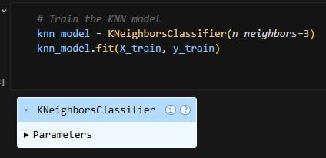
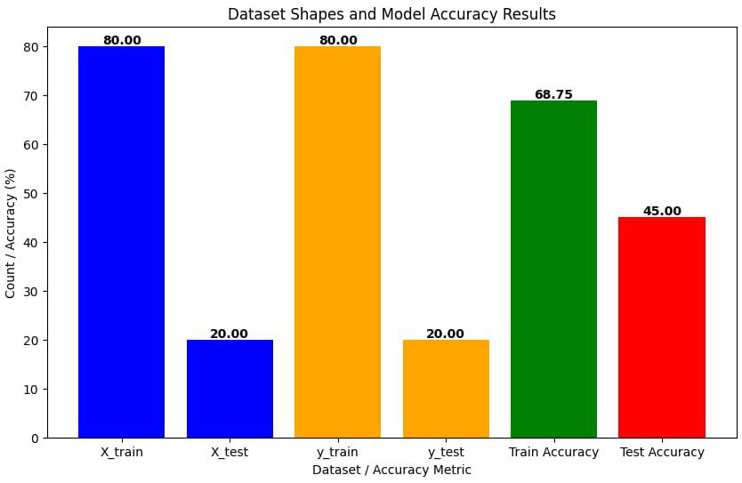
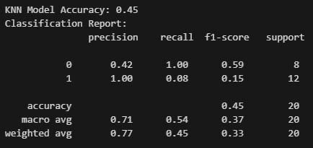
KNN
K-Nearest Neighbors (KNN) is a supervised learning algorithm that classifies or predicts a data point based on the majority vote (classification) or average (regression) of its K closest neighbors in the feature space, measured by distance metrics like Euclidean distance.
Group 8: Yakin Nazif Unaiza Nawar Tanisha Md. Rakibul Islam Rakib Md. Mobenul Islam Chowdhury

Slide 9
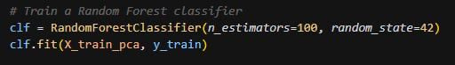
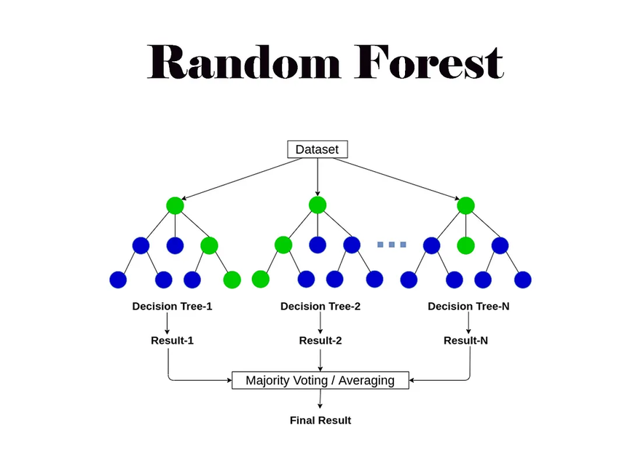
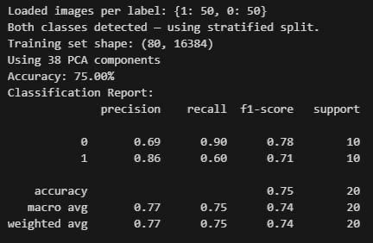
Random Forest
A random forest is an ensemble machine learning algorithm that builds multiple decision trees on random subsets of data and features, then combines their predictions through voting (classification) or averaging (regression) to improve accuracy and reduce overfitting.
Group 8: Yakin Nazif Unaiza Nawar Tanisha Md. Rakibul Islam Rakib Md. Mobenul Islam Chowdhury

Slide 10
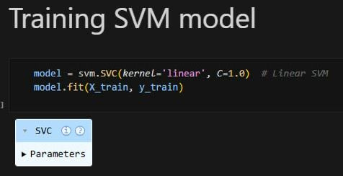
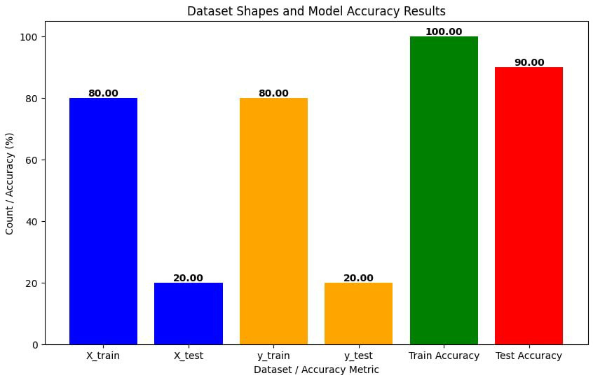
SVM
Support Vector Machine (SVM) is a supervised learning algorithm that finds the optimal hyperplane that maximally separates different classes by maximizing the margin between the closest data points (support vectors) of each class, and can handle non-linear boundaries using kernel functions.
Group 8: Yakin Nazif Unaiza Nawar Tanisha Md. Rakibul Islam Rakib Md. Mobenul Islam Chowdhury

Slide 11
Model | Advantage | Disadvantage
KNN | Simple and easy to implement. No training phase required. | Sensitive to irrelevant features and noisy data.Computationally expensive for large datasets (requires storing all training samples).
SVM | Effective for high-dimensional datasets (e.g., image features).Works well with smaller datasets due to its reliance on support vectors. | Computationally expensive for large datasets. Sensitive to noise and outliers
Random Forest | Robust to overfitting compared to a single decision tree.Performs feature selection during training. | Computationally expensive for large datasets.Can overfit with small datasets and deep trees.
Template Matching | Simple and works well for object detection in controlled environments | Computationally expensive for large template and search areas.
Group 8: Yakin Nazif Unaiza Nawar Tanisha Md. Rakibul Islam Rakib Md. Mobenul Islam Chowdhury

Slide 12
Challenges & Solutions
Throughout the project, we collectively have faced :
​
Challenge: We faced Overfitting due to small dataset.​
Solution: Implement cross-validation and regularization.​
Challenge: Complex backgrounds or partial occlusion of stop signs.​
Solution: We used advanced feature extractors (e.g., HOG, CNNs).​
Challenge : Variation in visibility of images​
Solution : Data augmentation increased accuracy from 80% to 92%​
​
Group 8: Yakin Nazif Unaiza Nawar Tanisha Md. Rakibul Islam Rakib Md. Mobenul Islam Chowdhury

Slide 13
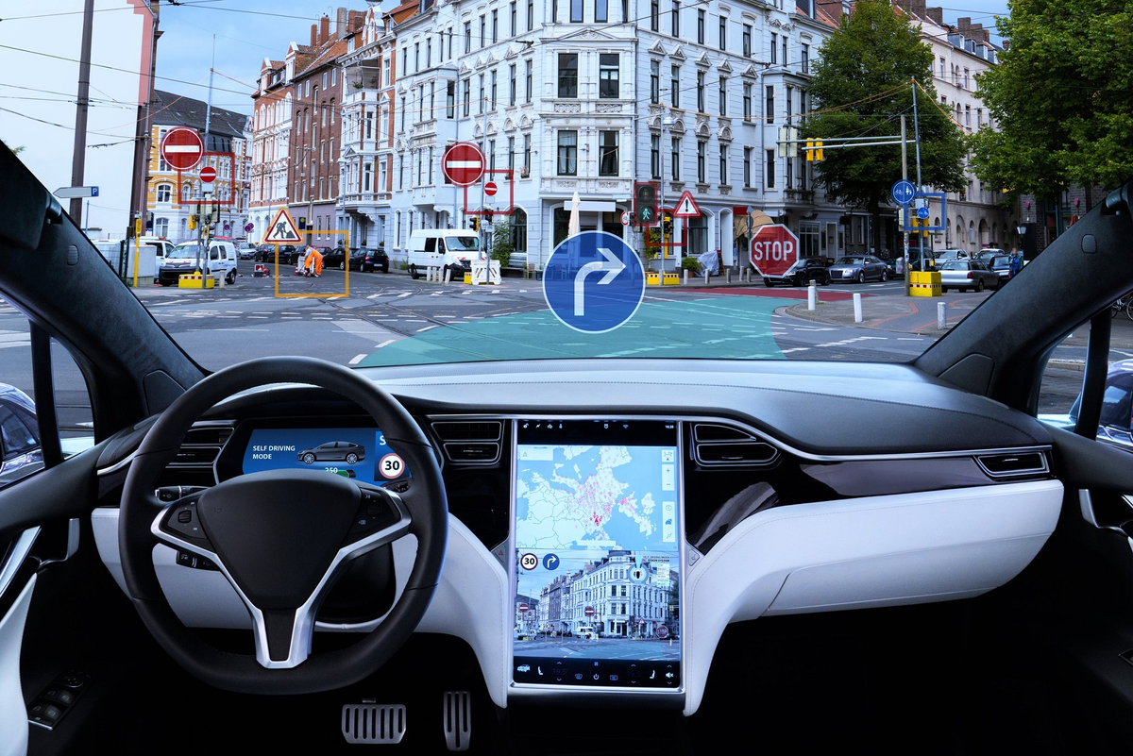
Future prospect of this technology
Autonomous Vehicles: Enables self-driving cars to accurately detect and stop at signs for safer navigation.
Driver Assistance Systems (ADAS): Alerts drivers to stop signs in vehicles, improving safety in poor conditions.
Traffic Enforcement: Cameras monitor intersections to detect and record stop sign violations automatically.
Smart Cities: Supports AI-driven traffic management for better flow and compliance monitoring.
Group 8: Yakin Nazif Unaiza Nawar Tanisha Md. Rakibul Islam Rakib Md. Mobenul Islam Chowdhury

Slide 14
Conclusion
This project demonstrated the implementation of SVM and KNN models for stop sign detection in street images. Despite their simplicity, both models showed limited performance due to the small dataset. The KNN model performed slightly better and was selected for its robustness in handling small datasets. Future work willfocus on expanding the dataset and exploring advancedmodels to improve accuracy.​
Group 8: Yakin Nazif Unaiza Nawar Tanisha Md. Rakibul Islam Rakib Md. Mobenul Islam Chowdhury

Slide 15
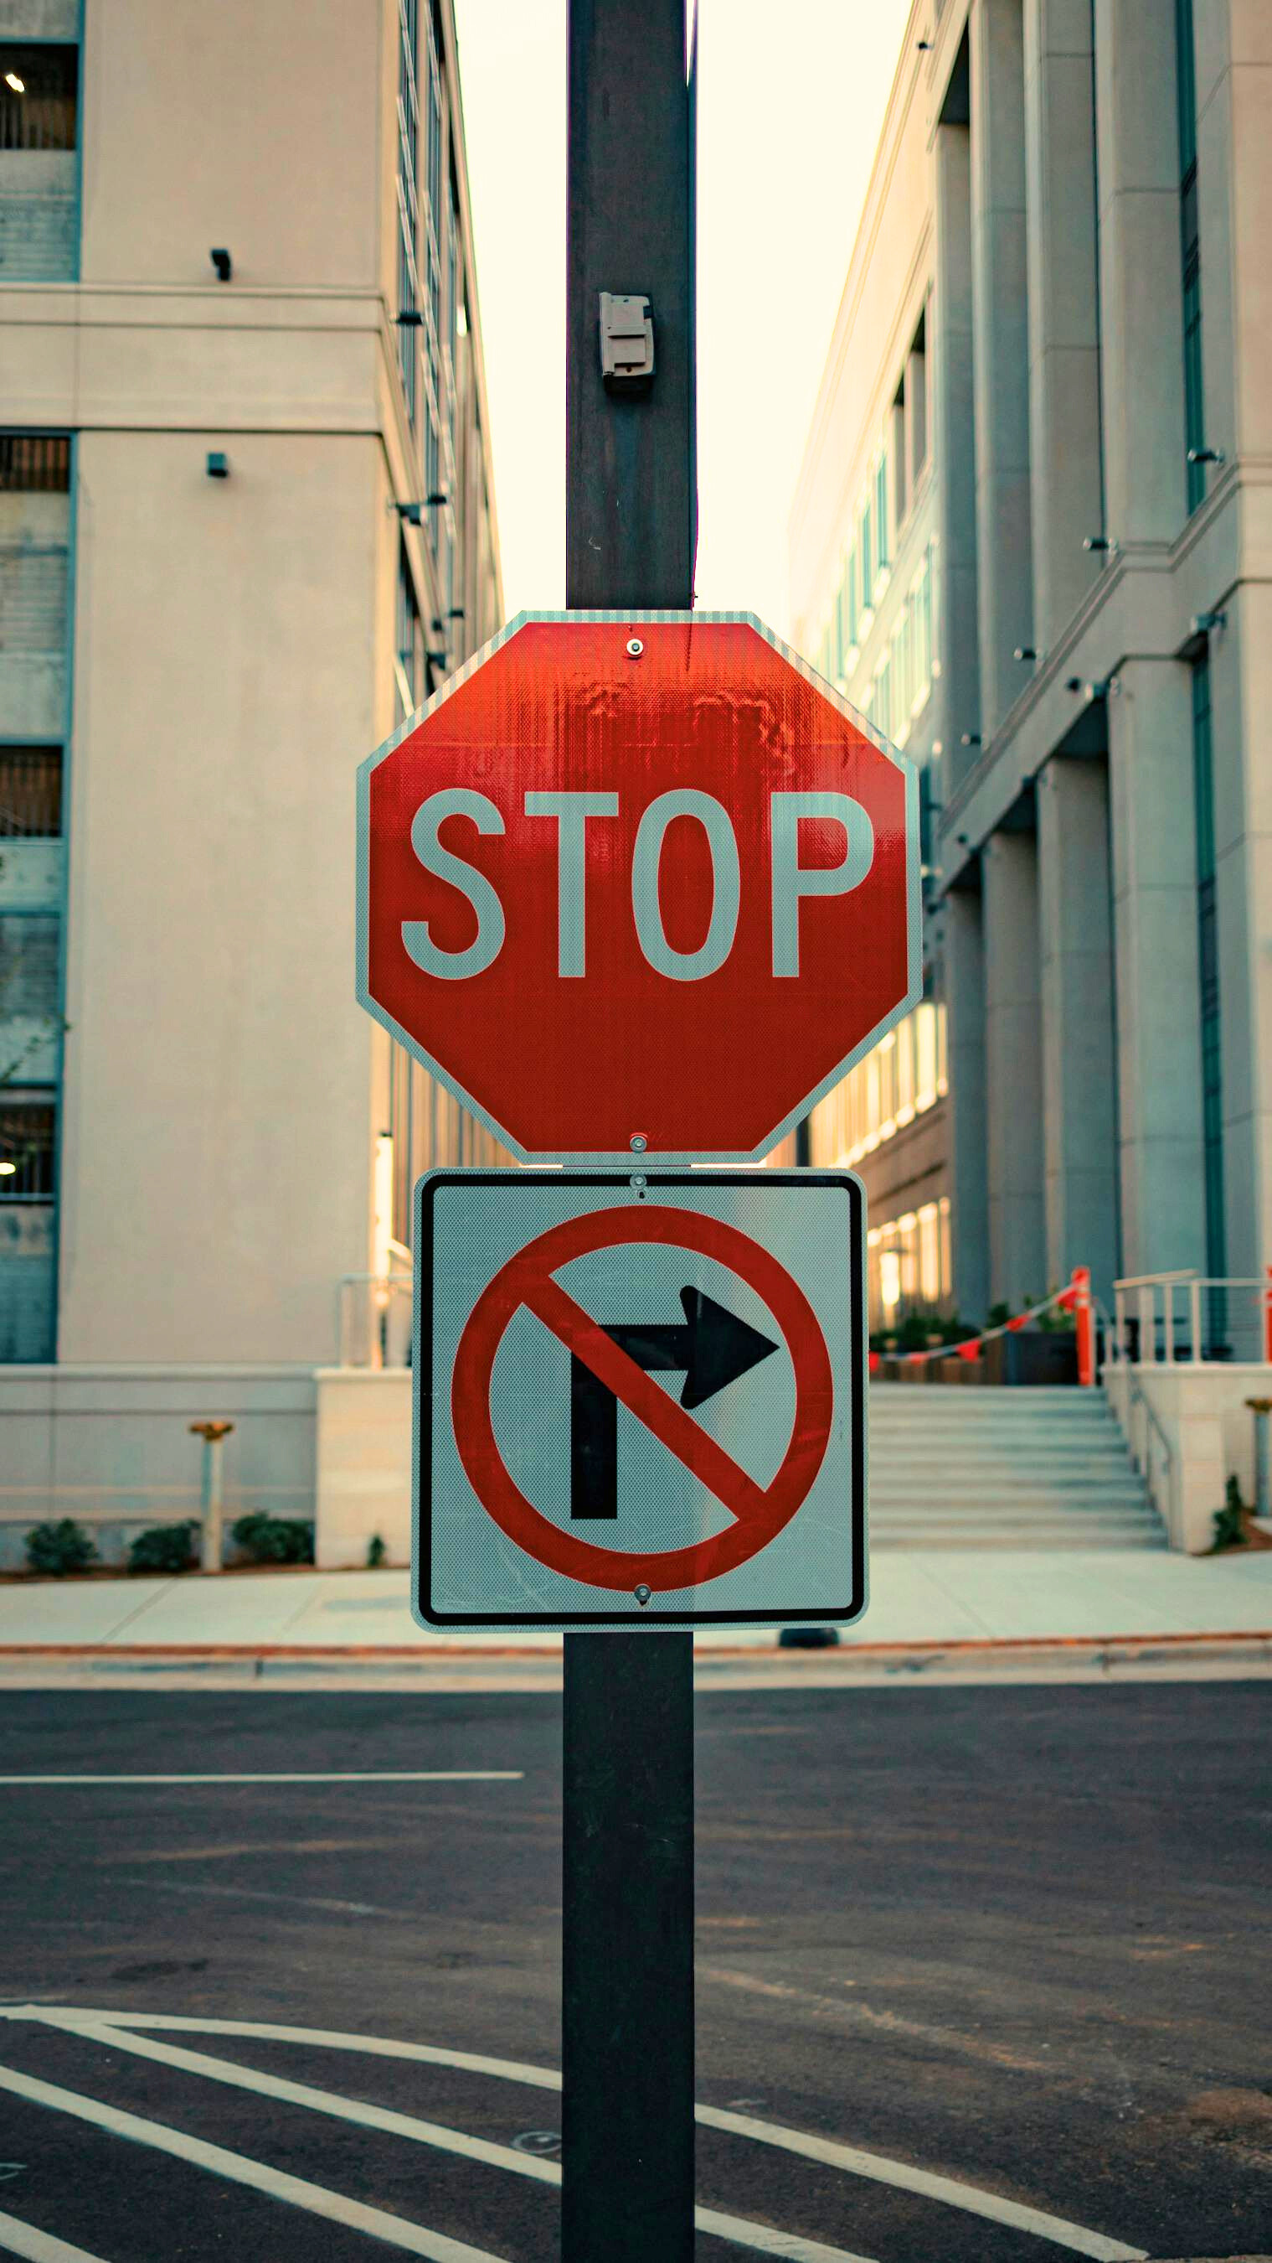
If you have any
questions, then
just kidding,
go ahead.
Group 8: Yakin Nazif Unaiza Nawar Tanisha Md. Rakibul Islam Rakib Md. Mobenul Islam Chowdhury

